Slide 1




SKILLS FOR SMALL BUSINESS (SSB) Program
Train your Workforce.
Transform your Business.

Slide 2


Invest In Your Employees
Skills training…
Increases competitiveness
Enhance your business operations
Upgrades new and incumbent employee skills
Retain employee talent
Prepares newly hired employees for job requirements

Slide 3

Areas of Grant Training
Office
(9 courses)
Office Technology
(12 courses)
Customer Service
  (7 courses)
Human Resources
  (6 courses)
Leadership
  (7 courses)
Manufacturing
  (16 courses)
Construction
  (16 courses)
Training Options: Face-to-Face (Classroom), Online or On-Site
SSB Catalog

Slide 4
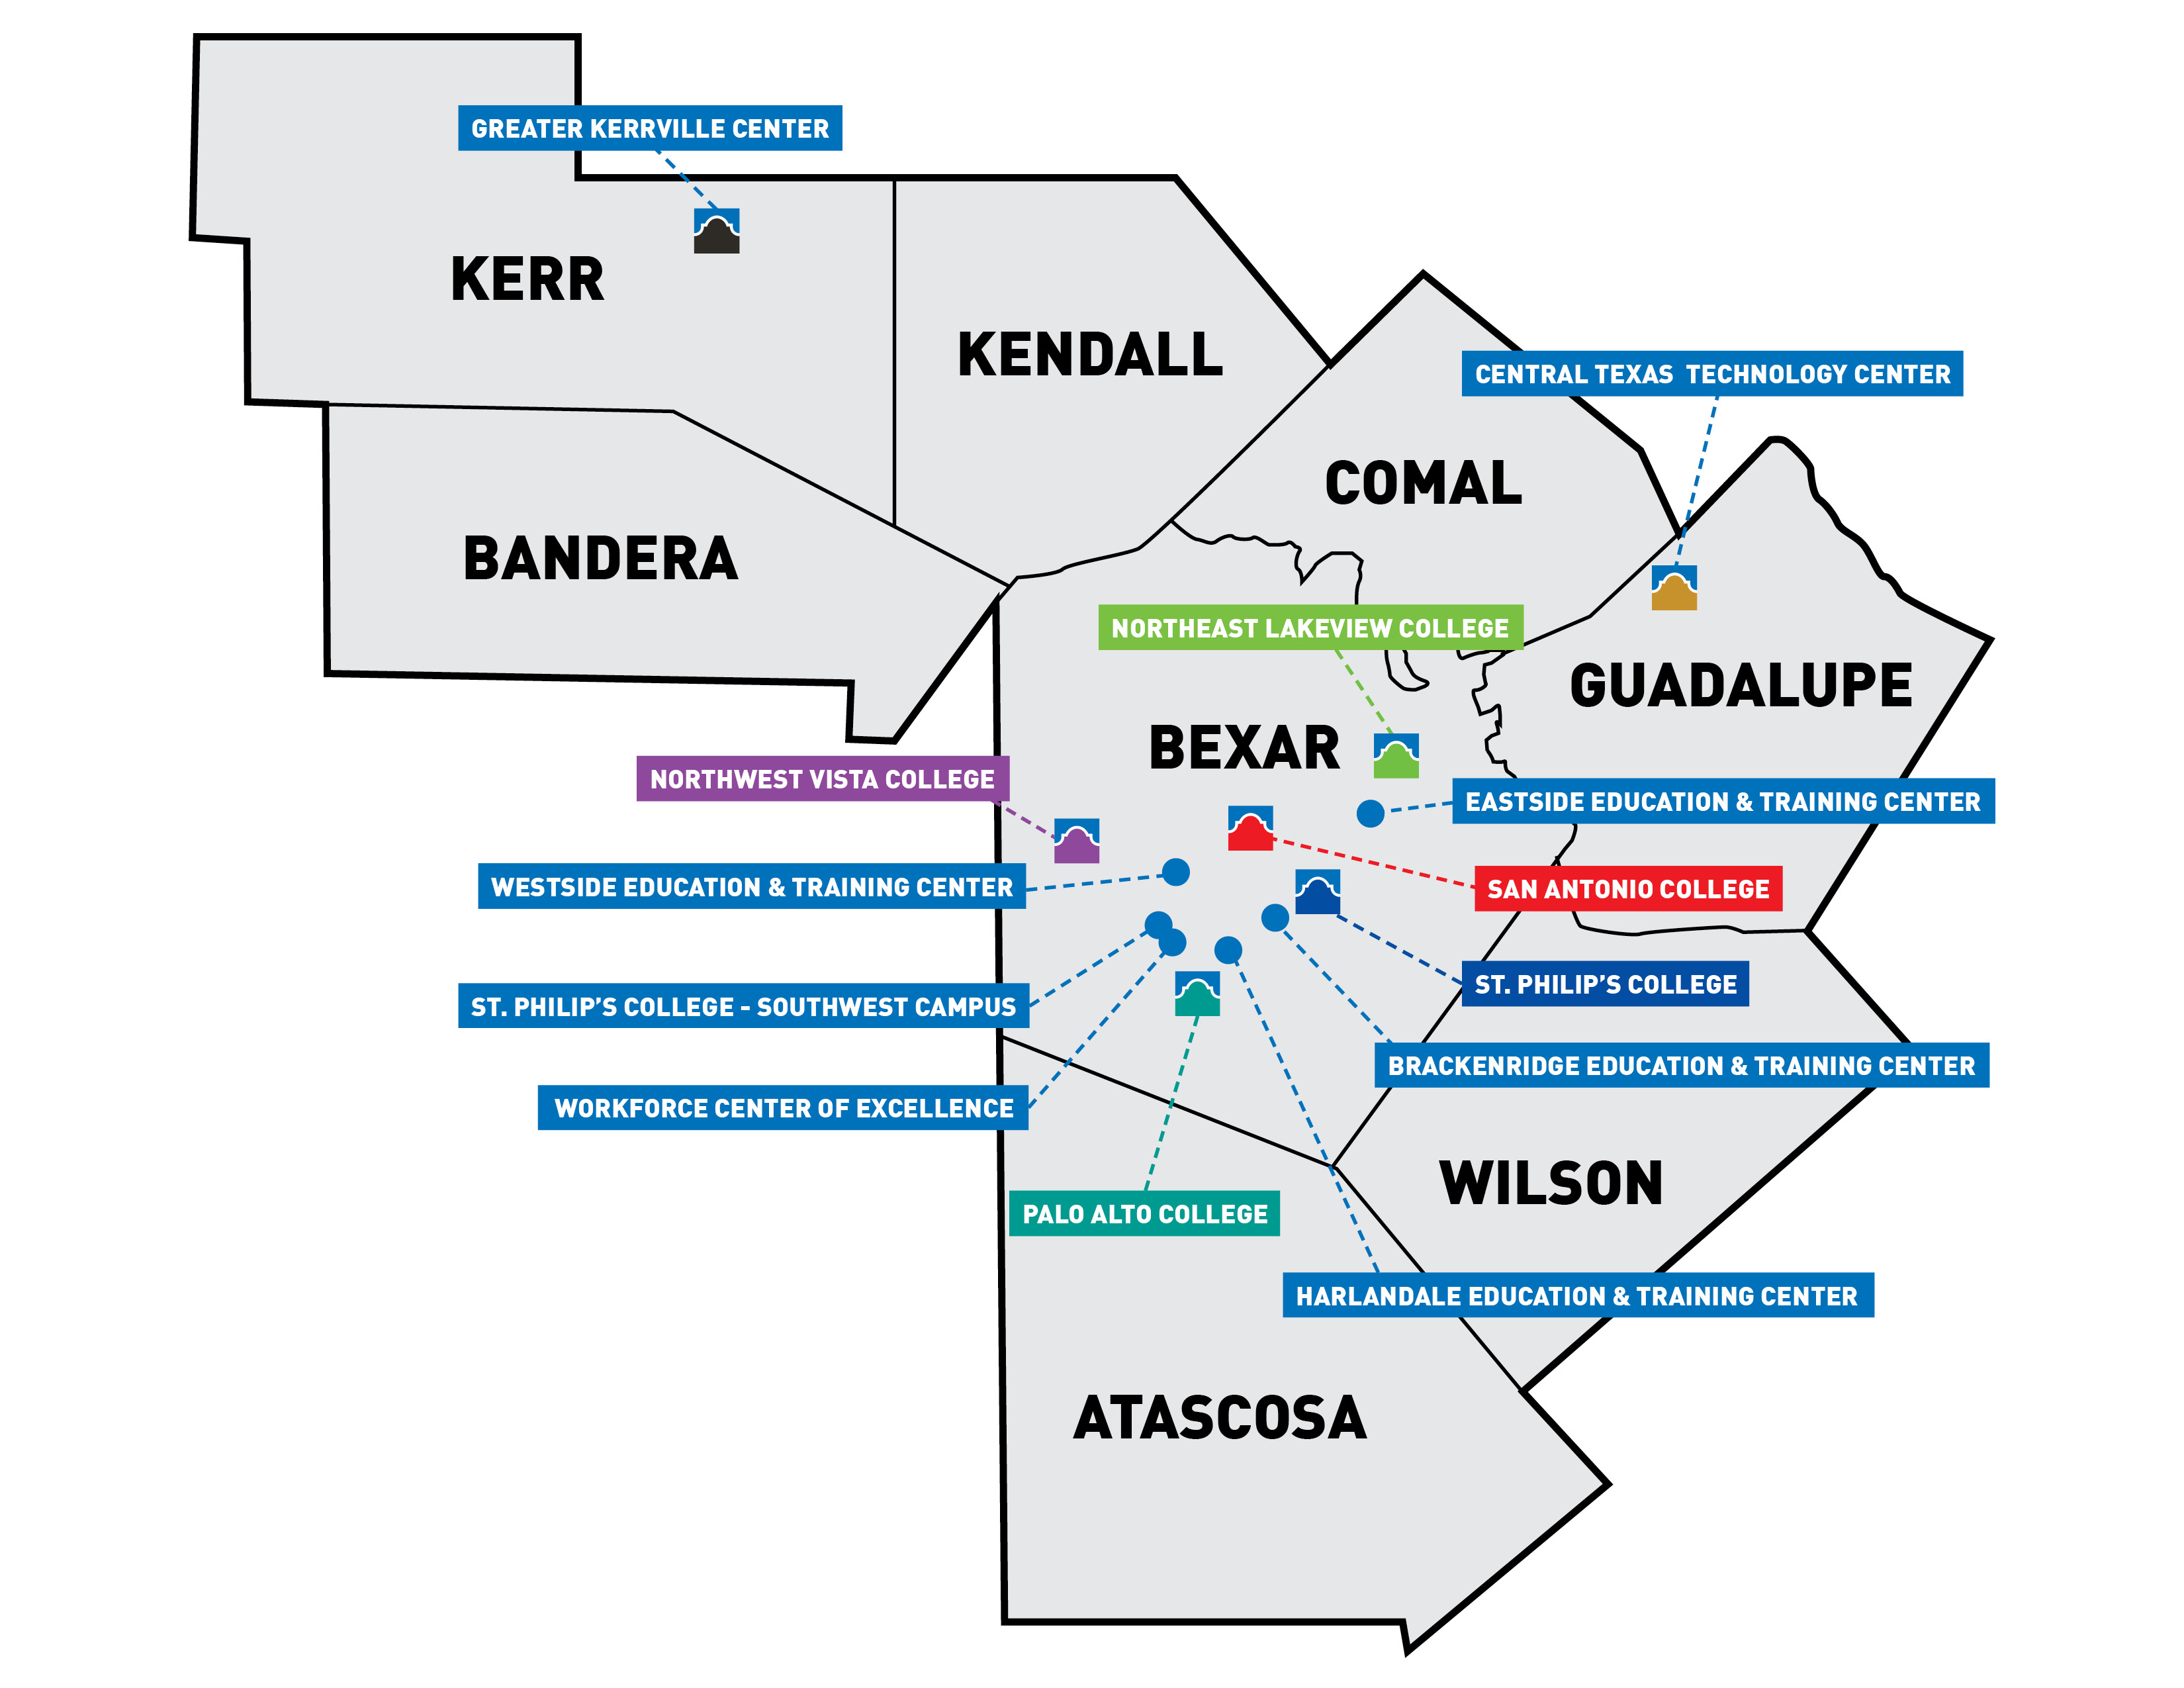

The Alamo Colleges District Family
Serving 8 Counties
5 Colleges
  San Antonio College
  St. Philip’s College
  Palo Alto College
  Northwest Vista College
  Northeast Lakeview College
7 Education & Training Centers
  Greater Kerrville (GTC)
  Central Texas Technology (CTTC)
  Eastside (ETTC)
  Westside (WETC)
  Workforce Center of Excellence (WCOE)
  Brackenridge & Harlandale (BETC/HETC)
2023 New Centers
  Southside (SETC)
  Northeast (NWETC)

Slide 5


Partner Testimonial
“Straight Line Management has been a participant in Skills for Small Business Program since 2018. The training our staff has received is invaluable. Through the Skills for Small Business Program, we've been able to train staff on QuickBooks, we've obtained OSHA and First Aid/CPR certification, as well as get our Field Techs certified as Forklift Operators. The program is a great staff development resource for small businesses.”
Jeanetta Tinsley, Project Manager

Slide 6

Eligible Small Businesses – 1 to 99 Employees
Trainees must be full-time employees
Must have Texas Workforce Commission (TWC) Unemployment Tax account
Be current on paying unemployment insurance
Must be paying prevailing wages
Private businesses are eligible to participate
Notes:
Any small businesses with 1 to 99 employees are ELIGIBLE for grant funding, ONLY if they meet the following requirements.
Trainees must be full-time employees
Must have Texas Workforce Commission (TWC) Unemployment Tax account
Be current on paying unemployment insurance
Must be paying prevailing wages according to local labor market (25th percentile)
Private businesses are eligible to participate

Slide 7
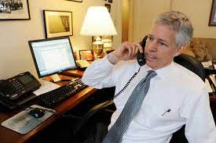

Ineligible Small Businesses
Self employed
Small businesses with no full-time, part-time, or 1099 employees
Businesses with over 100 employees
Community-based organizations, publicly funded entities, and other public non-profits are not eligible
Notes:
INELIGIBLE for grant funding, if they meet the following requirements.
Self Employed
Small Businesses with no full-time, part-time, or 1099 employees
Businesses with over 100 employees
Community-based organizations, publicly funded entities, and other public non-profits are not eligible

Slide 8


Training for New Employees
Have been in the current role for under a year
Must be a full-time, permanent employee
Must earn prevailing wage
TWC will cover tuition and fees up to $1,800 for new hire employees per 12-month period
EXAMPLE: New hire received $1,800 in tuition funds
OSHA 30 $908
CPR/First Aid $338
Customer Service $230
Basic Keyboarding $308
Total Spent $1,784 Remaining Balance $16
Notes:
The training funds are created as a drawdown funds through the local college.
Remaining balance does not carry over to the new year.
Training year (anniversary) is created on their first day of training. Example: March 1, 2023 to March 1, 2024.

Slide 9

Training for Incumbent Employees
Have been in the current role for over a year
Must be a full-time, permanent employee
Must earn prevailing wage
TWC will cover tuition and fees up to $900 for incumbent employees per 12-month period
EXAMPLE: Incumbent received $900 in tuition funds
OSHA 10 $366
CPR/First Aid $338
Generations in the Workplace $196
Total Spent $900
Notes:
Following the year the employee will become an incumbent employee.
Have been in the current role for over a year
Must be a full-time, permanent employee
Must earn prevailing wage
TWC will cover tuition and fees up to $900 for incumbent employees per 12-month period
The training funds are created as a drawdown funds through the local college.
Remaining balance does not carry over to the new year.
Training year (anniversary) is created on their first day of training. Example: March 1, 2023 to March 1, 2024.

Slide 10

Employer Online Application
3 Step Process
1. Go to the website
https://www.twc.texas.gov/businesses/skills-small-business-employers
2. Click on Apply Online
3. Complete the application,
sign and click finish
NEED ASSISTANCE?
TWC Workforce Business Services Outreach & Customer Support Team

Slide 11
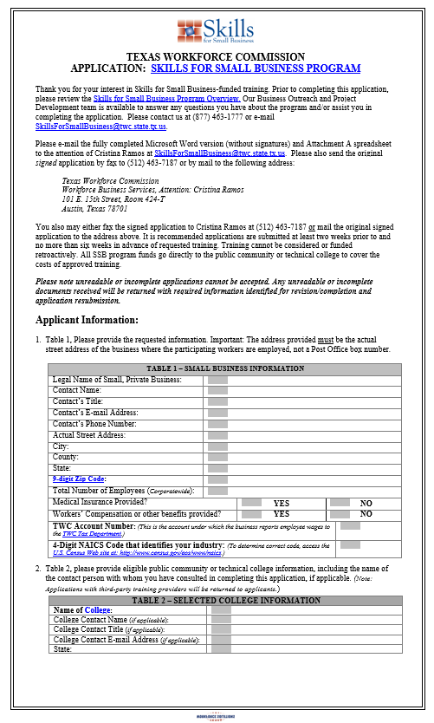
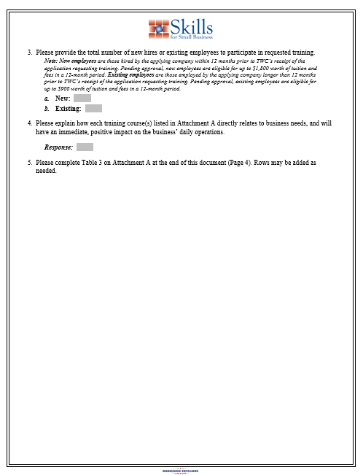
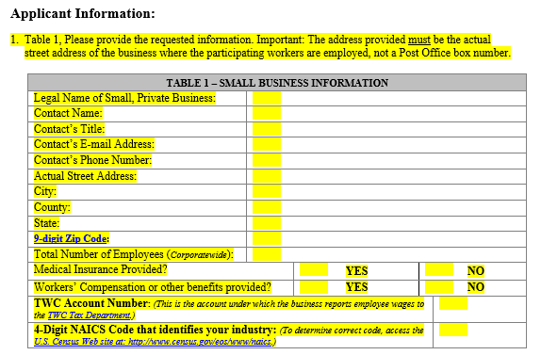
Information Required For Application – Table 1
Notes:
Documents they should have on hand?

Slide 12
Information Required For Application – Table 2
Questions 3 and 4:
Total number of new and existing employees to be trained
Explain how training relates to business needs
College Information
Name of College (Alamo Colleges)
College Contact Name (Kathy M. Fogle)
College Contact Email Address (kfogle3@alamo.edu)

Slide 13
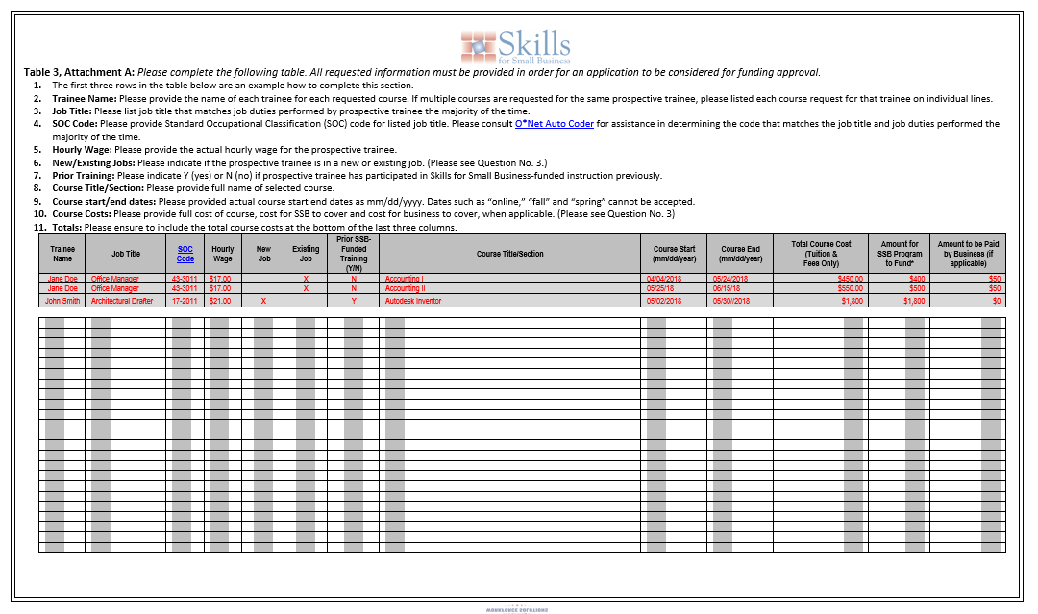
Information Required For Application – Table 3
O*NET-SOC Code
Assistance

Slide 14
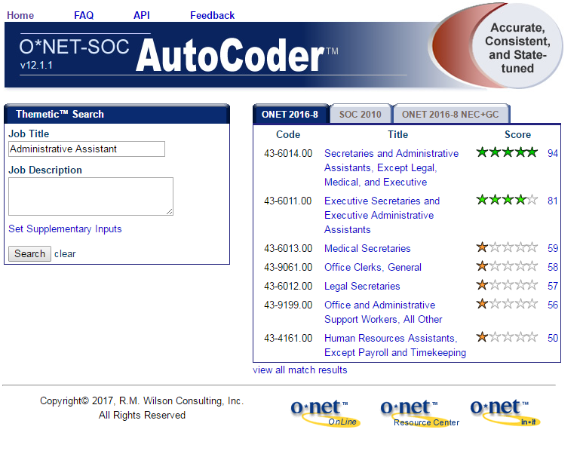

How to Find the O*NET-SOC Code
Go to this website
O Net Soc Auto Coder website can assist you in finding the employee job description SOC code for the grant employee spreadsheet.
http://www.onetsocautocoder.com/plus/onetmatch

Slide 15
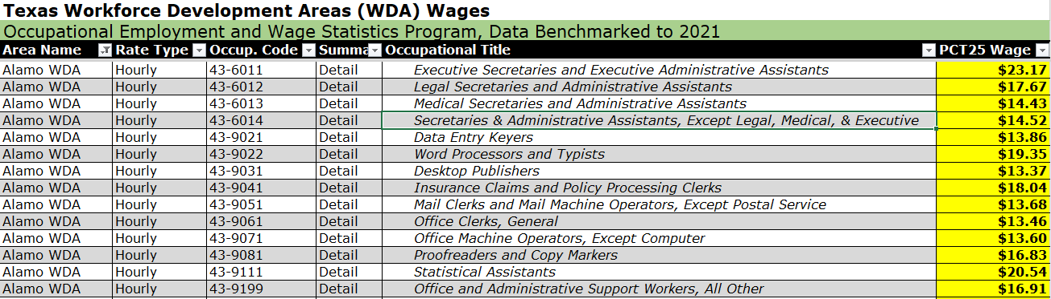
TWC Prevailing Wage Chart
Alamo Area

Slide 16
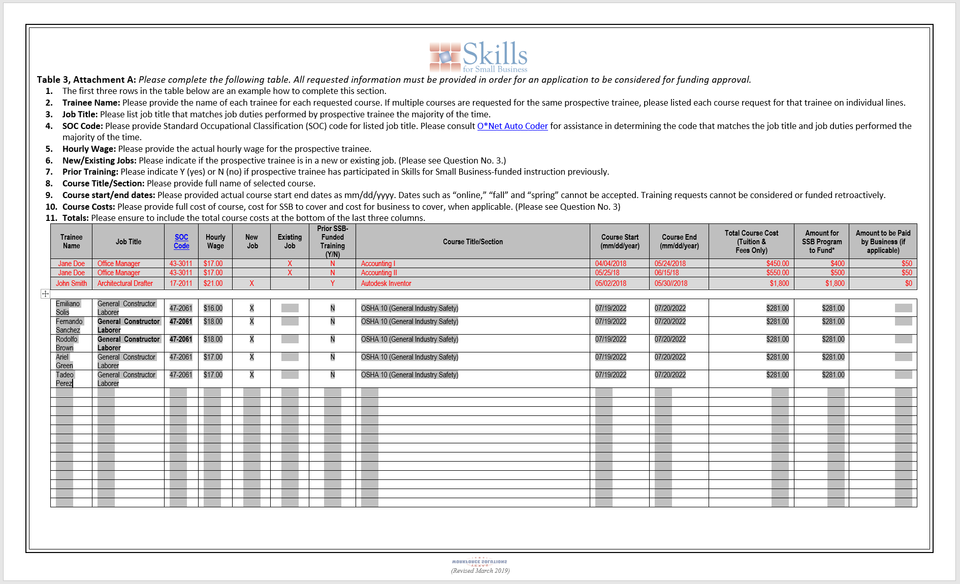
TWC Skills for Small Business Application – Table 3

Slide 17




TWC Skills for Small Business Application Process
1
Small Business
2
$$$
3

Slide 18
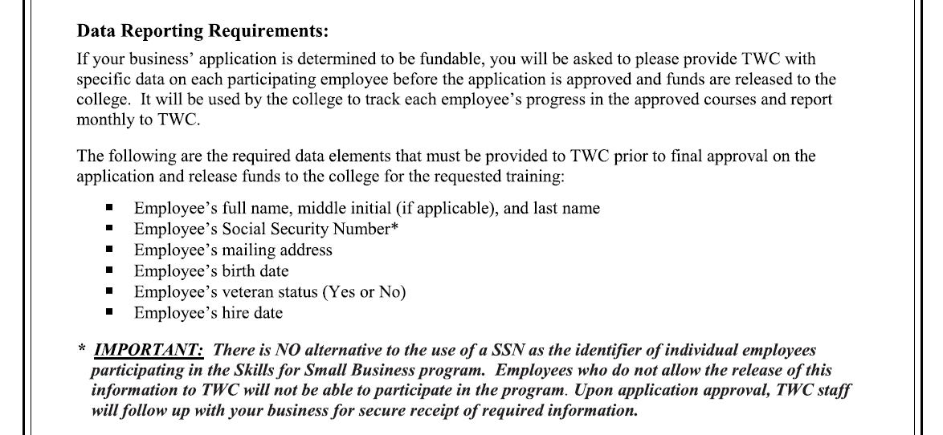
TWC Training Information Form (TIF)

Slide 19

Skills for Small Business Resources
Kathy Fogle, Account Executive
Alamo Colleges Center Operations
&
TWC Skills for Small Business Partner at
kfogle3@alamo.edu
(210) 485-0863

Slide 20
Thank you.
Learn more at
alamo.edu/SkillsforSmallBusiness

