Slide 1




2024-2025
Alamo Colleges Foundation Scholarship Reviewer Orientation
With Audio Recording
Notes:
Thank you for your participation in reviewing the 2024-2025 Alamo Colleges Foundation Scholarship applications.
This presentation will cover:
The scholarship judging site
Student scholarship application
Reviewing and scoring process
Troubleshooting
Scoring rubric

Slide 2

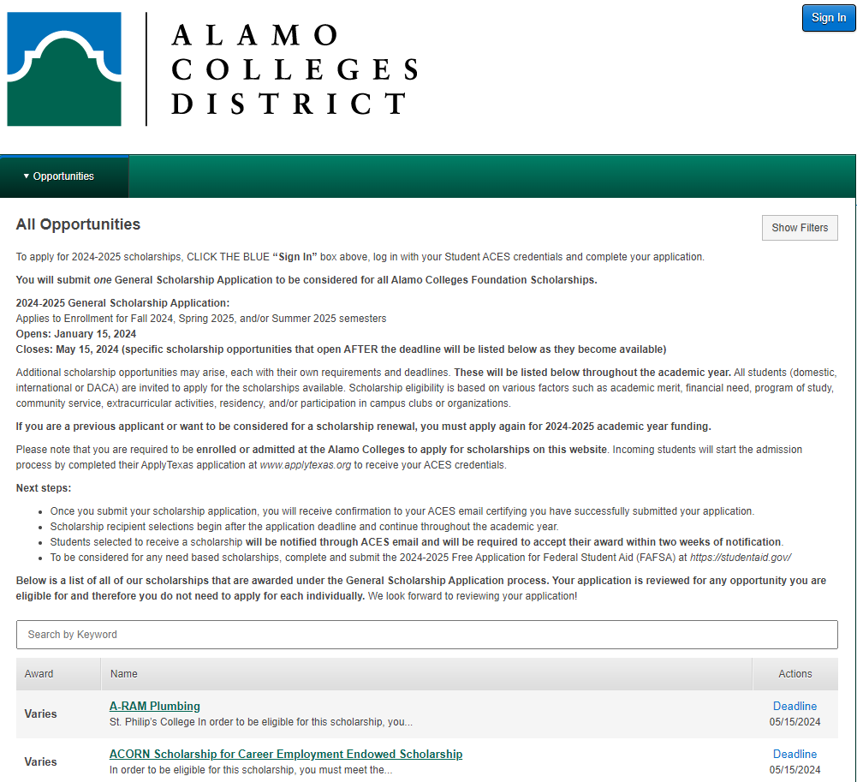
Scholarship Judging Site – Awards Management (Scholarship process and management system)
Keeps our scholarship program running efficiently by giving access to one central awards platform.
A single website makes it easy to promote all scholarships on each campus to our student population.
Nightly integration with our student information system shortens the time it takes to complete an application and improves the quality and accuracy of data on each application.
Notes:
The scholarship judging site is a process and management system that keeps our scholarship program running efficiently by giving access to one central awards platform.
This website makes it easy to promote all scholarships on each campus to our student population.
Nightly integration with our student information system shortens the time it takes to complete an application and improves the quality and accuracy of data on each application.

Slide 3

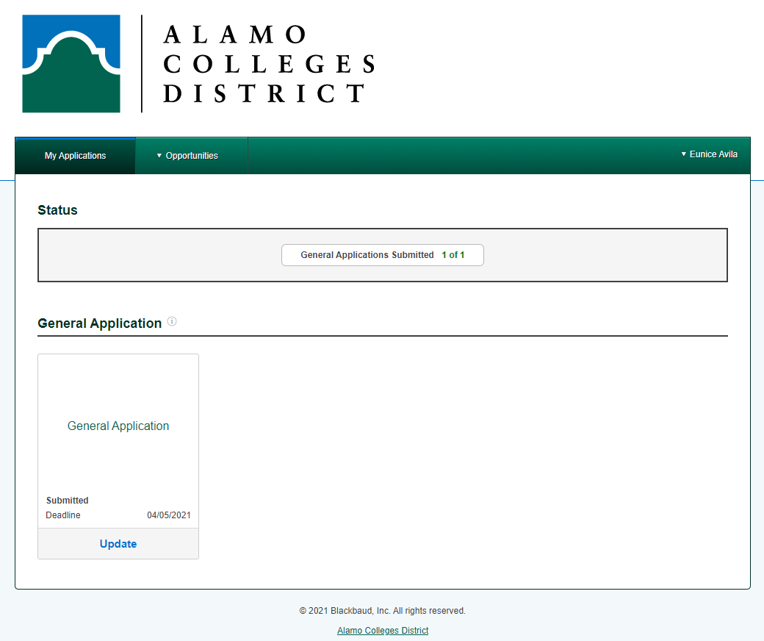
The Student Scholarship Application
Web-based application available to students 24/7
One application for full award year and considered for all Foundation scholarships
Important Dates
Application Opens: January 15, 2024
Application Closes: May 15, 2024
Application Review/Scoring Period: May 17 – May 29, 2024
Notes:
The Student Scholarship Application
This web-based application is available to students 24/7.
The general application is one application is for full award year and considered for all Foundation scholarships.
Some important dates to keep in mind leading up to the reviewing period are:
Application Opening date: January 15
The application closing date: May 15
And the application review/scoring period: May 17 - May 29

Slide 4
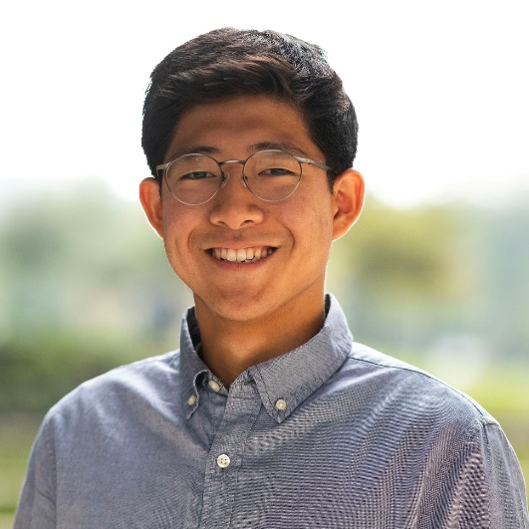
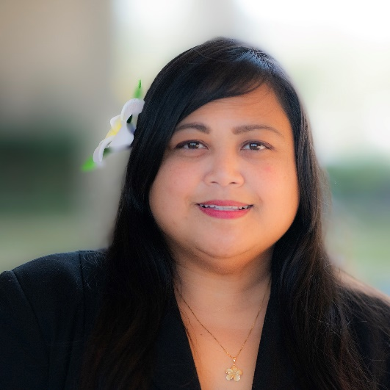
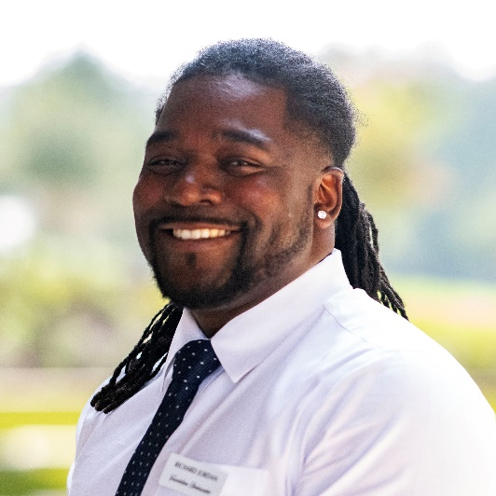



Reviewing/Scoring Process
The reviewer process begins on May 17 – May 29, 2024. All reviews are due on May 29th.
It is estimated that up to 4 hours will be needed to complete all assigned reviews.
It is recommended that you complete approximately 5 reviews shortly after receiving the sign-in link, so that you can correctly estimate the amount of time needed to complete all reviews.
If for any reason you are unable to complete the reviews assigned to you, please contact the Scholarship team as
soon as possible at dst-scholarship@alamo.edu.
Notes:
The review process will be from May 17 – May 29. All reviews will be due on May 29th.
Keep in mind that it is estimated that up to 4 hours will be needed to complete the assigned reviews throughout the reviewing period.
It is recommended that you complete approximately 5 reviews shortly after receiving the notification email that the reviewing process has started, so that you can correctly estimate the amount of time needed to complete all reviews.
If for any reason you are unable to complete the reviews assigned to you, please contact the Scholarship team as soon as possible at dst-scholarship@alamo.edu.

Slide 5
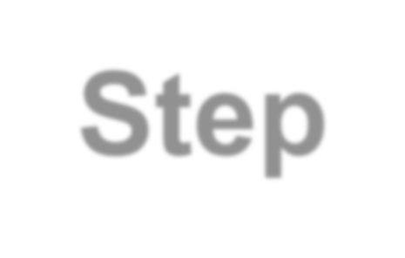
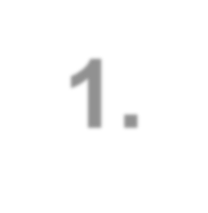
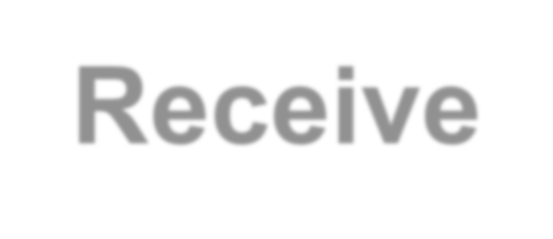
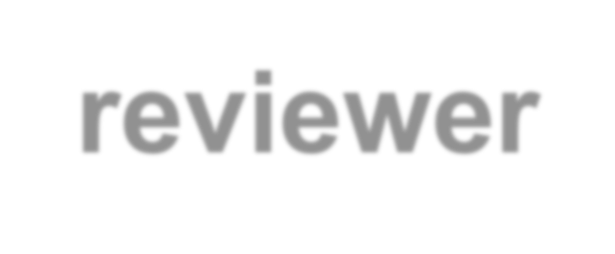

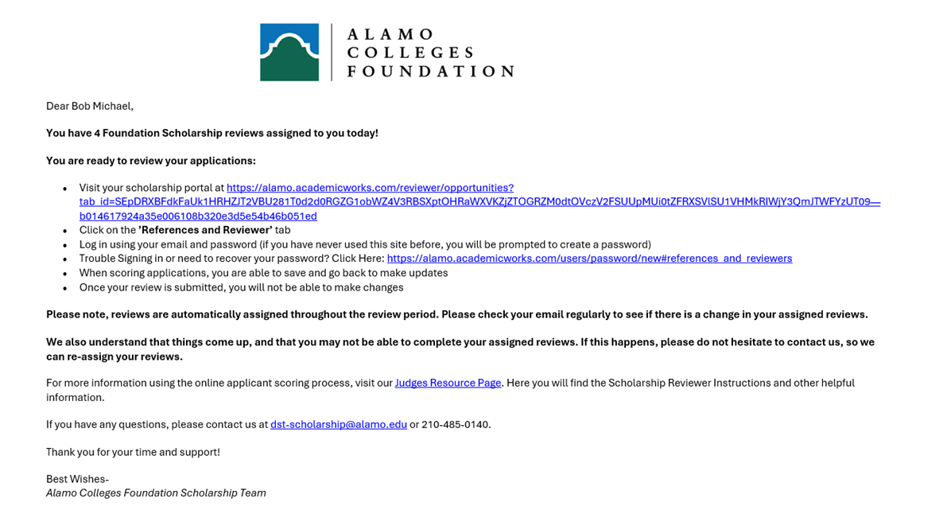
Step 1. Receive reviewer email
You will receive an email from dst-scholarship@alamo.edu on May 17th
The email contains the link to log into the system to begin reviewing applications, and a link to watch an instructional video on the process.
Notes:
This is an example of the email you will receive from dst-scholarship@alamo.edu when the review period opens on May 17th
The email will contain the link to log into the system and steps to begin reviewing applications.
Your login will be used to access the scholarship portal.
The email will also provide helpful links to help with trouble signing in or helpful resources using the Judges Resource Page.

Slide 6
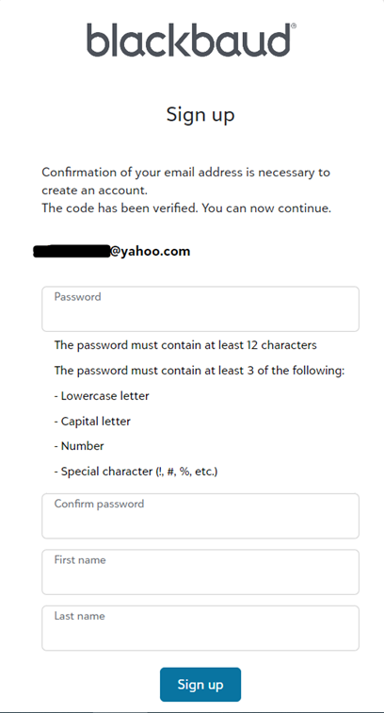
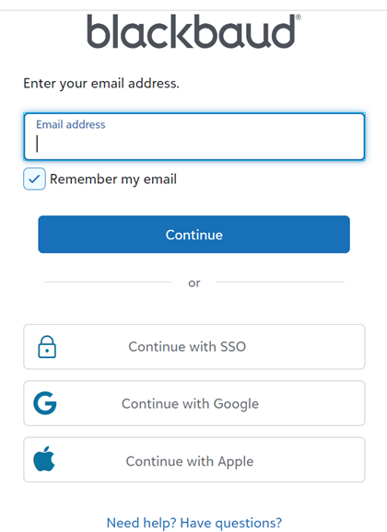
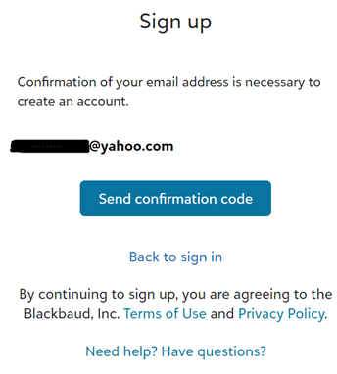
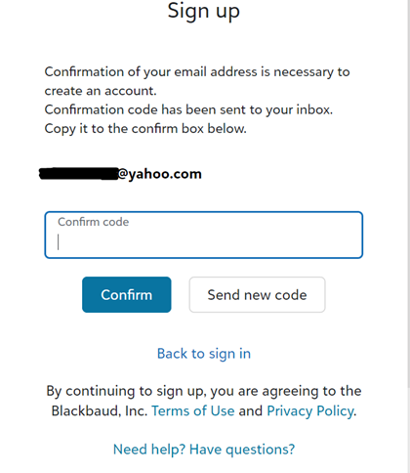
Creating your login credentials
Create your password.
Enter the exact email address where the committee reviewer link was sent.
Copy the confirmation code that was sent to your email to confirm.
Confirm the email address and send confirmation code.
Notes:
When establishing your login credentials, you will be prompted to verify your email address by entering a confirmation code.
Please ensure that you input the exact email address to which the review link was initially sent to.
Upon successful email confirmation, proceed to generate your password, ensuring it includes the requisite characters as indicated.

Slide 7
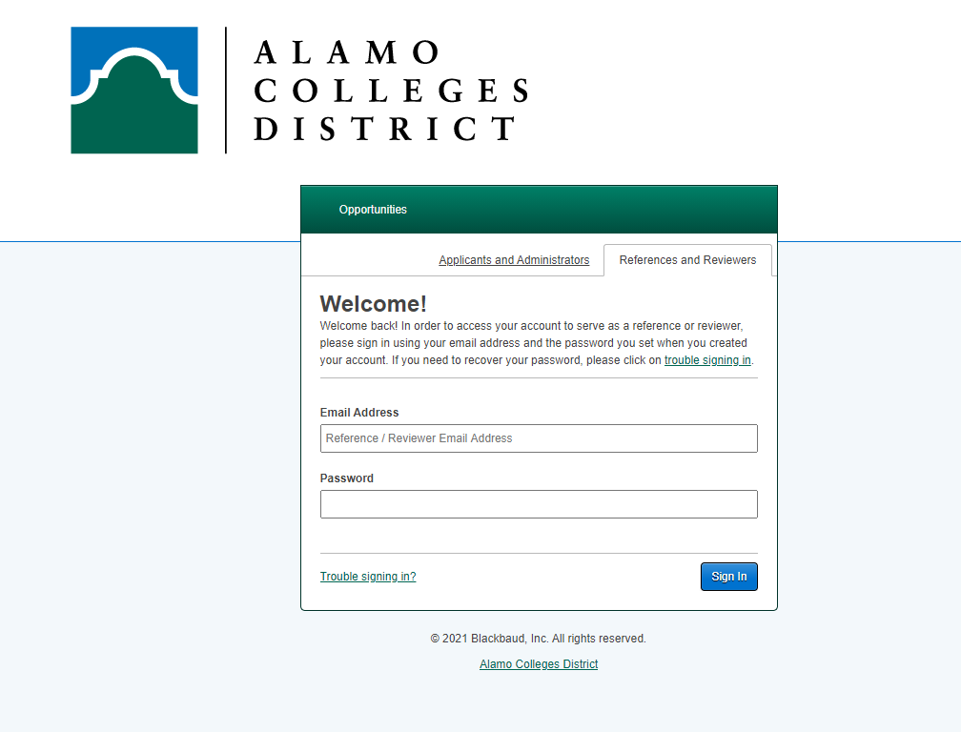
Step 2. Choose Reference & Reviewers Tab
To log in,
you must click on the “References and Reviewers” tab.
The “Applicants and Administrators” tab is for students that want to apply.
Notes:
When prompted to login using the login credentials you created, make sure you are on the Reference and Reviewers tab
The Applicants and Administrators tab is preferred for students that want to apply.

Slide 8
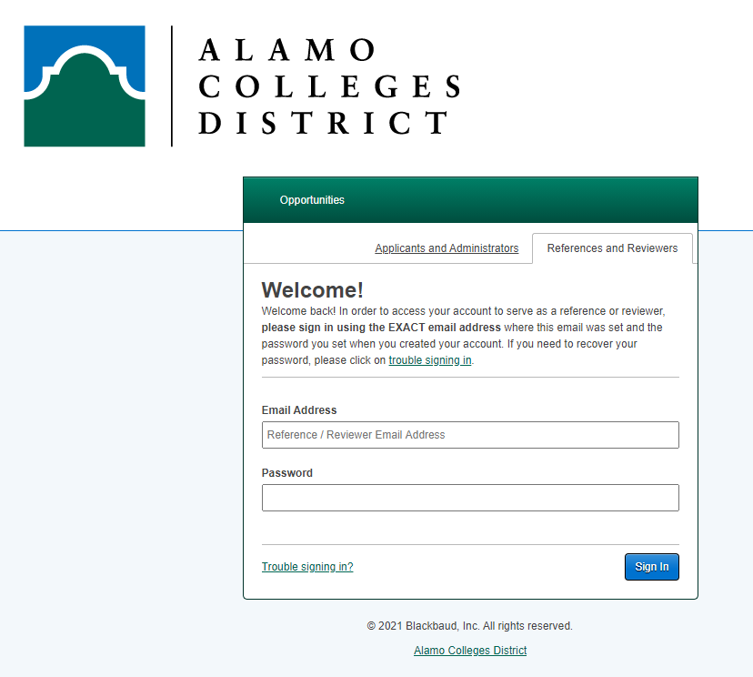
Step 3. Signing In
When you have your login credentials, Sign In using the same email address the link was sent to and your created password.
If you have participated in judging previously, it will be the
same password.
Your password will be reused each time you Sign-In as a reviewer
Please contact the scholarship team if you are needing assistance dst-scholarship@alamo.edu
Notes:
Once on the reference and reviewers tab, sign in using the same email address the link was sent to and the password you created.
If you have participated in judging previously, it will be the
same password.
If you are a new reviewer, please follow the steps to create your password when you receive the initial email with the login instructions.
Your password will be reused each time you sign-in as a reviewer.
If you need any assistance or have questions, please contact the scholarship team at dst-scholarship@alamo.edu

Slide 9
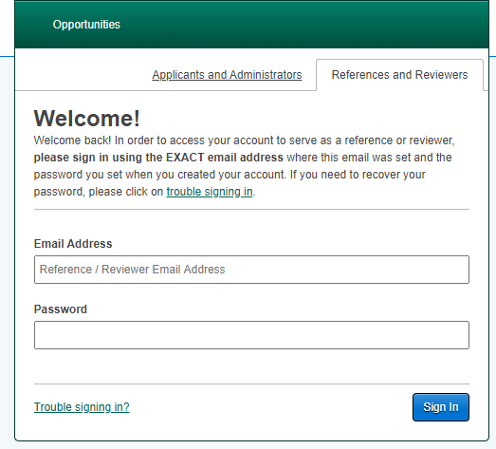
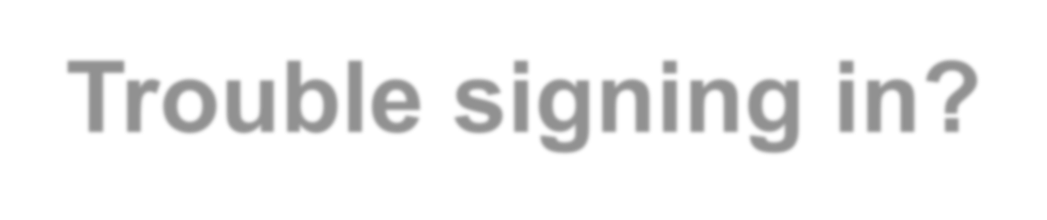
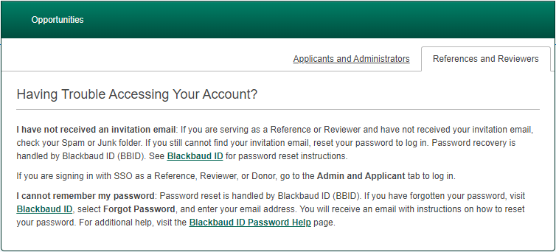
Trouble signing in?
Click the “Trouble signing in” link in the lower left corner
To reset your password…
Enter the exact email address where the committee reviewer link was sent.
2. Click on “Forgot Password” in the lower right corner.
3.Confirm your email by sending a confirmation code and follow the password reset instructions as referenced on the ‘creating your login credentials’ slide.
For assistance, kindly reach out to the scholarship team at dst-scholarship@alamo.edu.
Notes:
Here are some options if you are having trouble signing into the portal:
Under the field where you would enter your email and password, click the green trouble signing in link.
You will be directed to a ‘Having Trouble Accessing Your Account’ popup:
Read through the prompts and follow the instructions according to your trouble.
If you need to reset your password, enter the exact email address where the reviewer link was sent to.
Click on “Forgot Password”
You will receive an email with a confirmation code
Once confirming your email with the confirmation code, you will be redirected to create your new password.
If you continue experiencing trouble signing in, please contact the scholarship team at dst-scholarship@alamo.edu

Slide 10

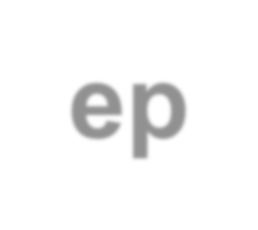
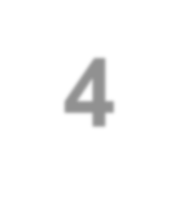






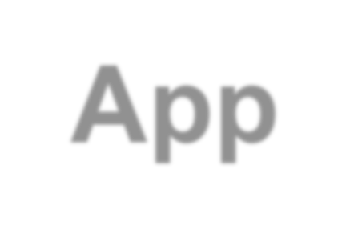
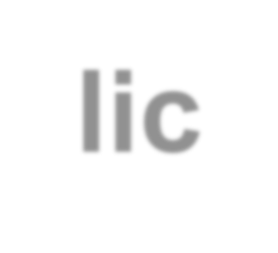




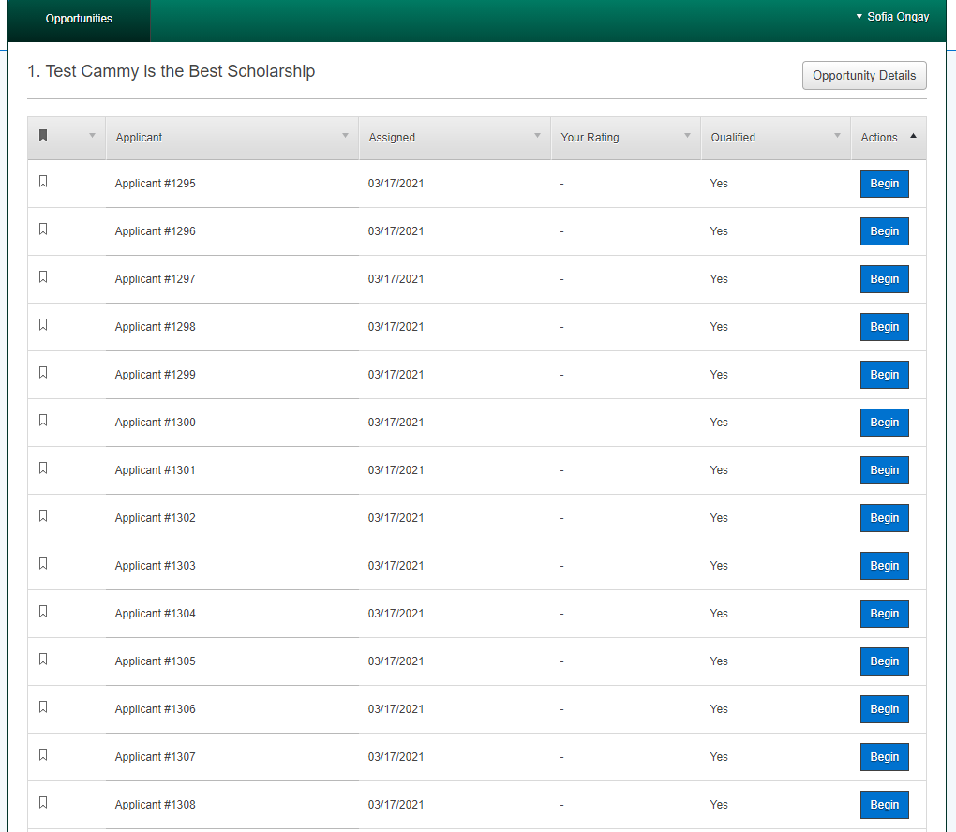
Step 4. General Applications
View the list of students that you are assigned to review.
All applicants are listed anonymously.
Notes:
Step 4. General Applications
Once signed in to review applications, you will see a list of applicants that are assigned to you to review.
Each applicant will be named anonymously as shown in the example image.

Slide 11
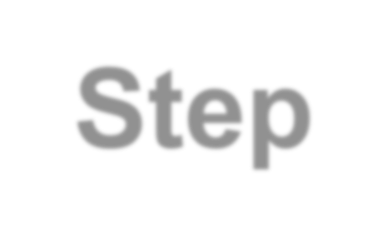
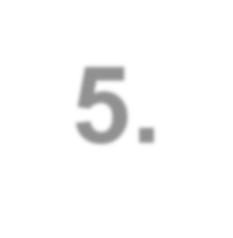
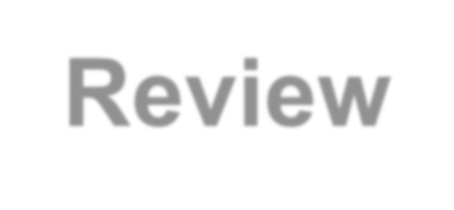
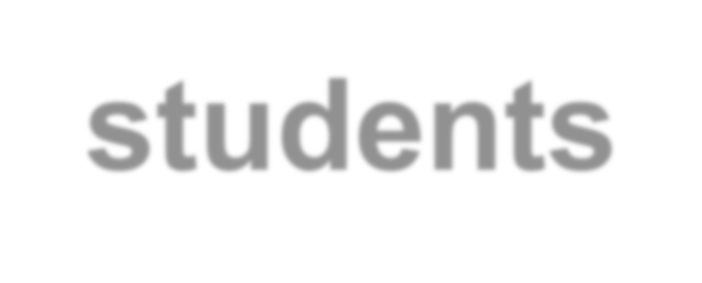
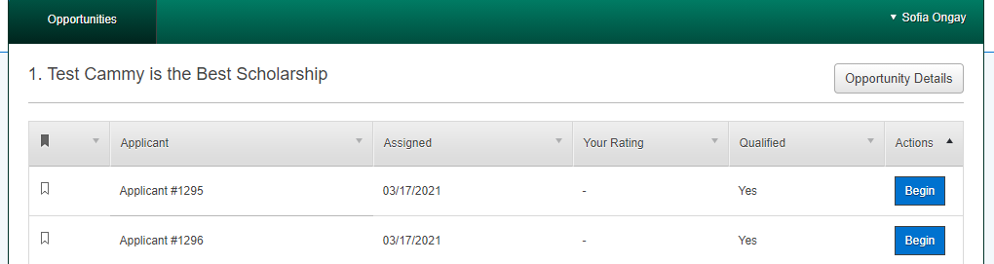
Step 5. Review students
Click “Begin” to review a candidate.
Notes:
Step 5. Review Students
Within your list of applicants, you can choose an applicant to review and click begin to review their application.

Slide 12
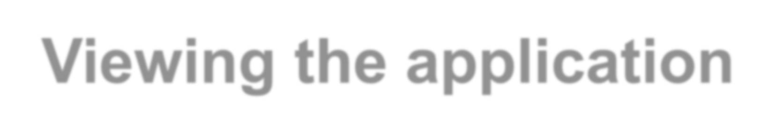
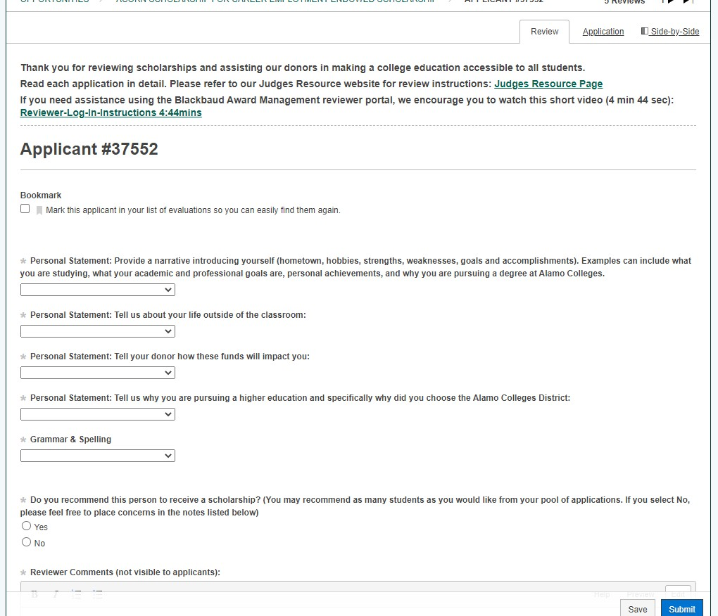
Viewing the application
The “Review” tab is where you will list the scores. To view the application, click the “Application” tab
or switch to
“Side-by-Side”
to review the student’s application and the review tab at the same time.
Notes:
Viewing the Application
When you enter the application, you will be taken to the review tab as you will see on the top right corner.
This is where you will list the scores.
You can view the application by choosing the "application tab" on the top right corner.
The side-by-side tab allows you to view both tabs (the review and application) at the same time.

Slide 13

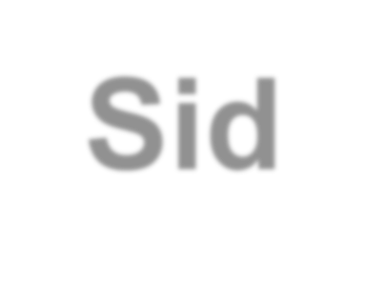
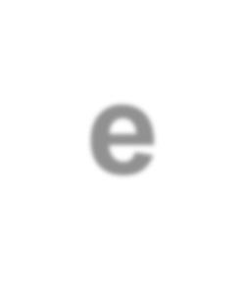



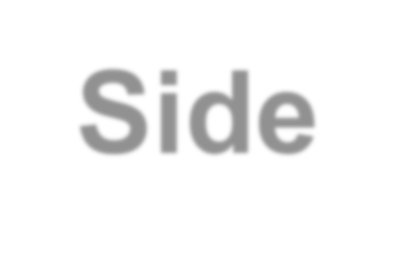
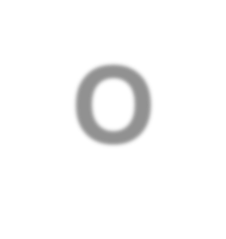

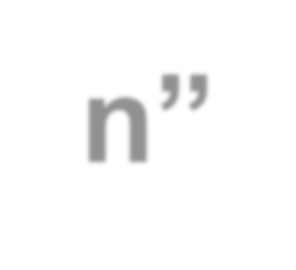
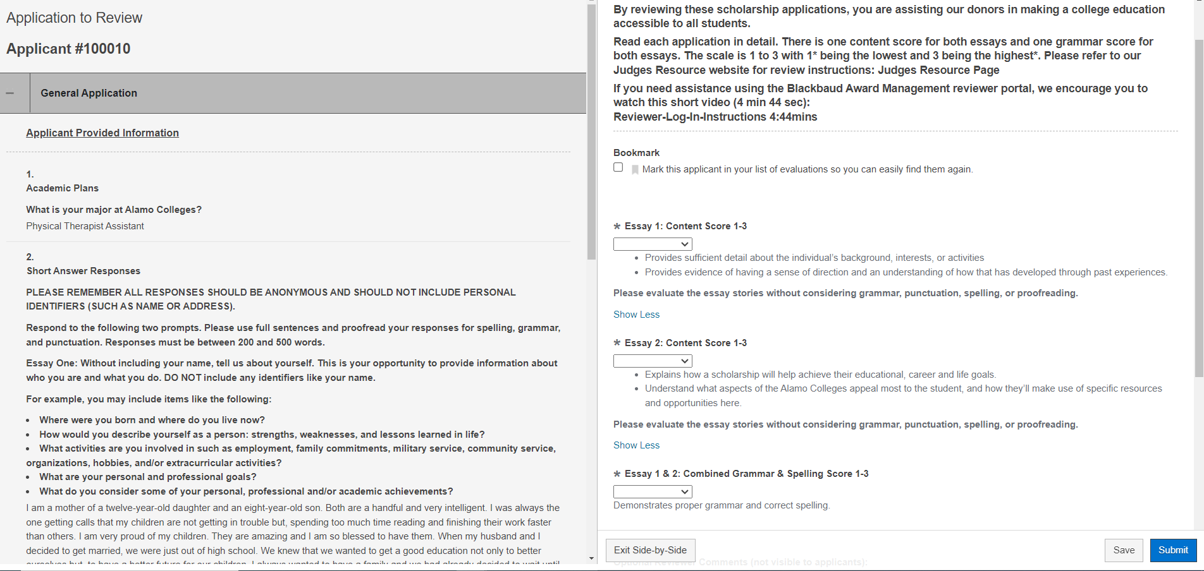
“Side-by-Side Option” (Recommended)
This allows you to scroll to review the student’s application and essays next to your rating criteria for quick reference.
Notes:
Side by Side Option
It is recommended to use the side-by-side view that allows you to scroll the student’s application and essays next to your rating criteria for quick reference.
To scroll through the reviewing page and the application for quick reference to both tabs

Slide 14


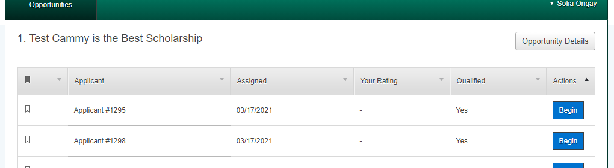
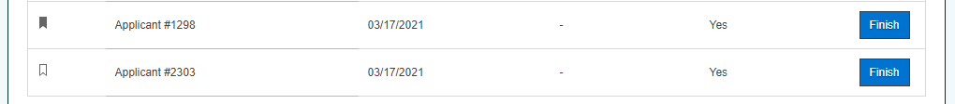
Bookmark feature
This feature makes it easy to find an applicant you may want to come back to review.
To review students with a bookmark, click on “Finish”.
Notes:
Bookmark Feature
To the left of every applicant on your list, you will see a bookmark icon.
This feature makes it easy to find an applicant you may want to come back to review.
To review students with a bookmark, click on finish to go back to reviewing the applicant.

Slide 15
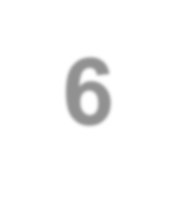


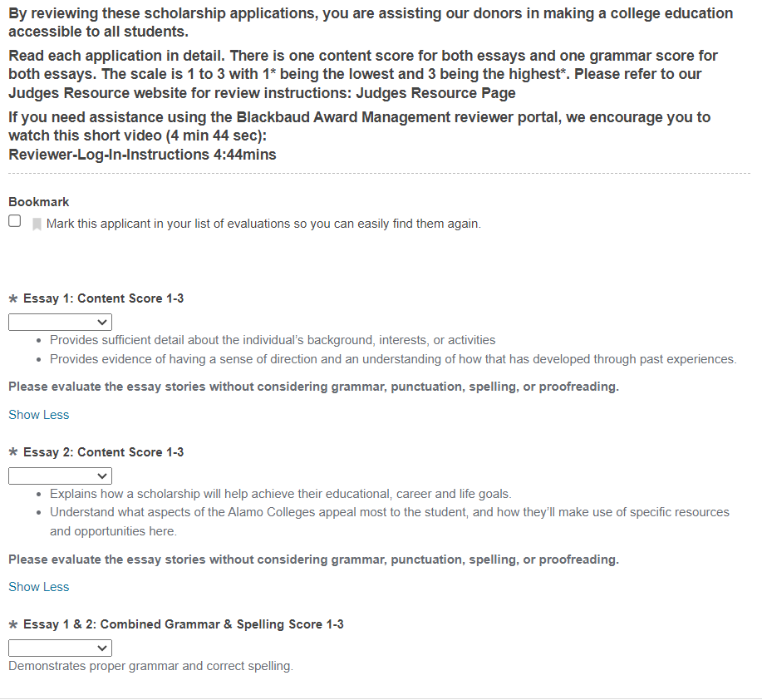
Step 6. Review & Score
Rate the applicants using the scoring rubric. (See on next page)
Scores will be listed 1-3. Select the drop down on each item to select the score.
Notes:
We will be rating the applicants using the scoring rubric which we will see more in the next few slides.
The scores will be ranked on a scale from 1 to 3 for Essay 1, Essay 2, and Essay 1 & 2 Combined Grammar & Spelling.
When your ready to score, select the drop down on each item to select the score as shown in the image.

Slide 16

Scoring Rubric – Essay Information to Review
Essay 1: Without including your name, tell us about yourself. This is your opportunity to provide information about who you are and what you do.
For example, you may include items like the following:
Where were you born and where do you live now?
How would you describe yourself as a person: strengths, weaknesses, and lessons learned in life?
What activities are you involved in such as employment, family commitments, military service, community service, organizations, hobbies, and/or extracurricular activities?
What are your personal and professional goals?
What do you consider some of your personal, professional and/or academic achievements?
Essay 2: Tell us why you are pursuing a higher education at Alamo Colleges and how a scholarship would impact you. This is your opportunity to explain your academic goals and how a scholarship would directly affect reaching that goal.
For example, you may include items like the following:
Why are you choosing to continue your education at Alamo Colleges?
What would receiving a scholarship mean to you?
What are your academic, educational, career, financial, and/or personal goals and how would a scholarship help you?
Describe what you are studying and why?
Are there any specific issues that receiving a scholarship would solve for you?
What expenses would a scholarship most help with?
Notes:
This slide shows the essay Information for each prompt
Essay 1 instructs the applicant to tell the reviewer about themselves and to provide information about who they are without giving their names.
While Essay 2 is asking for the applicant to tell us why they are pursuing a higher education at Alamo Colleges and how a scholarship would impact them.
With each prompt applicants are given examples they can include as a guide for their essays.

Slide 17
Scoring Rubric - Points
Essay 1: – up to 3 points
Provides sufficient detail about the individual’s background, interests, or activities.
Provides evidence of having a sense of direction and an understanding of how that has developed through past experiences.
Essay 2: – up to 3 points
Explains how a scholarship will help achieve their educational, career and life goals.
Understand what aspects of the Alamo Colleges appeal most to the student, and how they’ll make use of specific resources and opportunities here.
*Please evaluate the essay stories without considering grammar, punctuation, spelling, or proofreading.*
Grammar & Spelling Combined for essay 1 & 2: – up to 3 points
Demonstrates proper grammar and correct spelling.
Notes:
Scoring Rubric - Points
This slide shows what reviews can look for when reading each essay and how to score them
Each essay will be eligible to be scored up to 3 points each.
Please evaluate the essay stories without considering grammar, punctuation, spelling, or proofreading. There is a separate score for grammar and spelling for both essays 1&2 combined.
The grammar and spelling for both essays combined will be eligible to be scored up to 3 points

Slide 18
Scoring Rubric
Notes:
Scoring Rubric
The rubric when assigning points to Essay 1, Essay 2, and Essay 1 &2 combined grammar and Spelling is explained here.
Each score will be based on a 1-3 rubric.
1 point - Below Expectations
2 points - Meets Expectations
3 points - Exceeds Expectations
Each table explains what reviewers look for when scoring the essays.

Slide 19
Step 7. Finish & Submit
Don't forget to hit 'Submit' after scoring to finalize your rankings.
Notes:
When you are finished scoring an applicant, click submit, on the bottom right of the review page, to finalize your rankings.

Slide 20


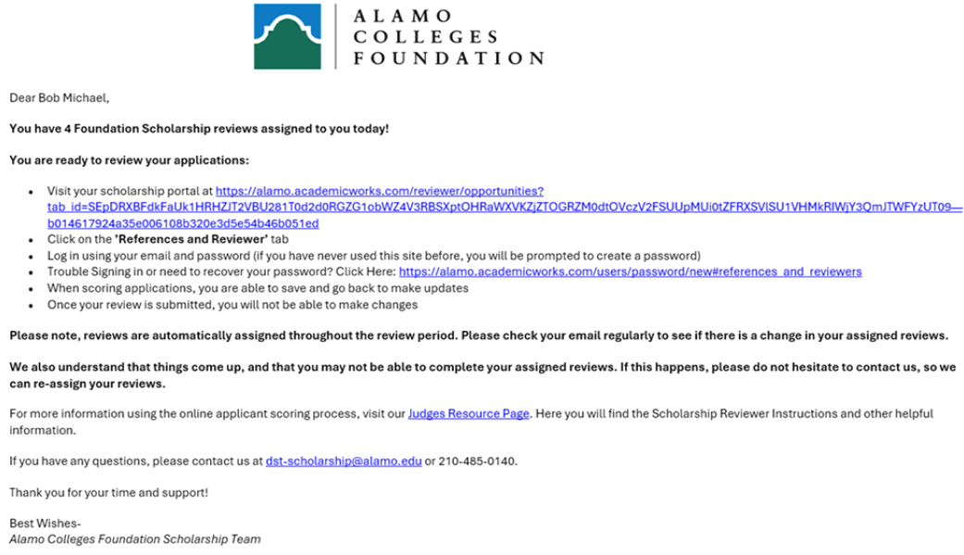







Questions & Answers
What if I am no longer available to score/ review applications?
Contact the Scholarship Team at dst-scholarship@alamo.edu. They will be able to redistribute your list of applications to the other reviewers.
What if I finish judging my list of applicants before the application/scoring period is over?
It is recommended to check your list of applicants throughout the reviewing period. Additional applications can be distributed to reviewers daily.
Notes:
Questions and Answers
These are a couple of questions and answers to keep in mind during the review period:
What if I am no longer available to score applications?
Contact the Scholarship Team. They will be able to redistribute your list of applicants to the other reviewers.
What if I finish judging my list of applicants before the application/scoring period is over?
It is recommended to check your lists every day until the review period is over. There are times when the applications are redistributed to the other reviewers in case a reviewer is no longer available to score applications.

Slide 21
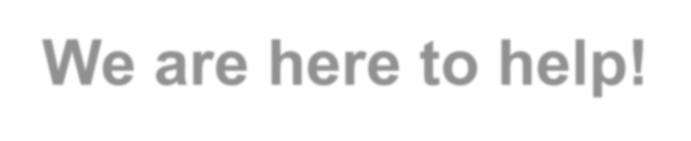
We are here to help!
Your role is vital to the scholarship selection process. Thank you for taking the time to assist our students!
For questions, please contact the Scholarship Team:
Amy Carcanagues
acarcanagues@alamo.edu
O: (210) 485-0776
Evelyn Campos
ecampos134@alamo.edu
O: (210) 485-0140
Sofia Ongay
songay@alamo.edu
Notes:
Your role is vital to the scholarship selection process.
For any questions, please contact the Scholarship Team at their information provided.
Thank you for taking the time to assist our students during the application reviewing period!

Slide 22


Thank you.

Slide 23





