Slide 1

Fall 2024

Slide 2
Dr. Francisco Solis
President
State of San Antonio College

Slide 3

2024 Performance Update
Dr. Francisco Solis

Slide 4

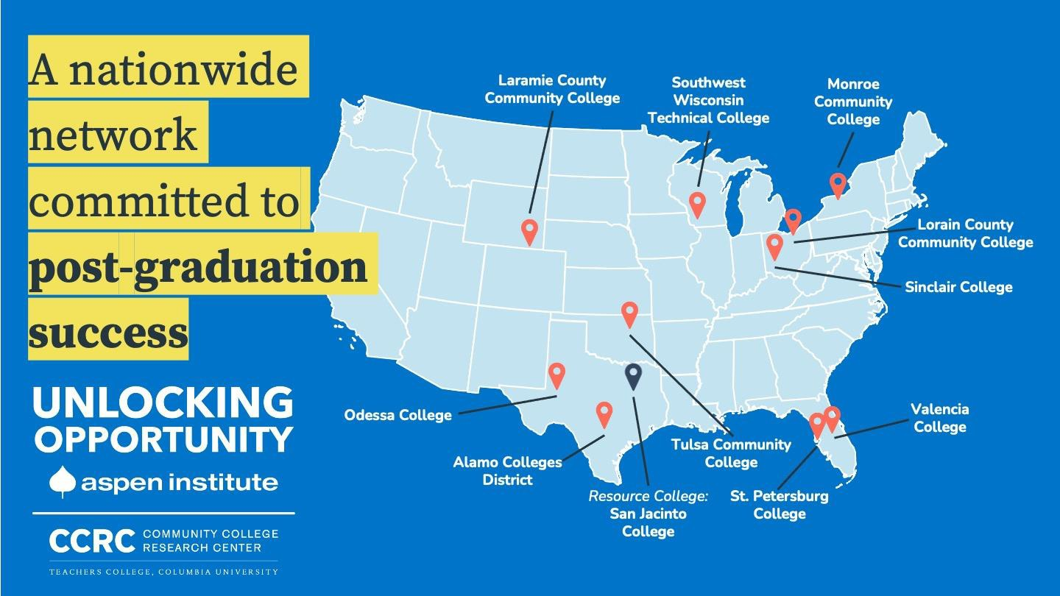

Unlocking Opportunity (UO) is a research and action group with one overarching goal: thousands more community college students entering and completing programs that have high post-completion value in that they enable graduates for secure jobs that pay family sustaining wages or transfer efficiently to a bachelor’s degree program.

Slide 5
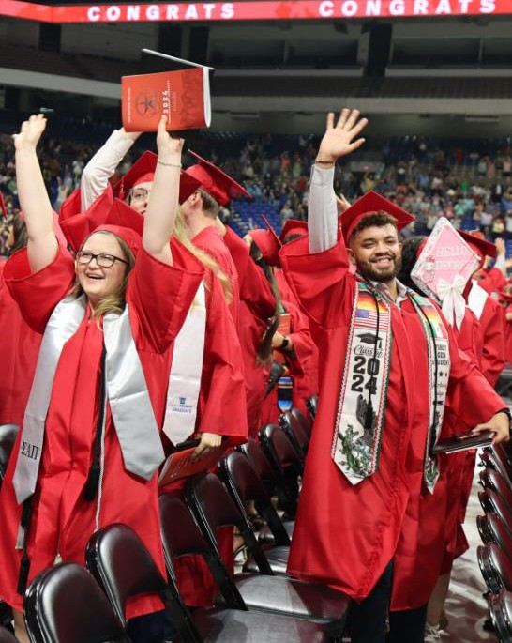



2024 Learner Performance Highlights
Increases in Enrollment Increases in Completion Rates
Increases in Productive Grade Rates
3-Year Freshmen Graduation Rates
Average Time to Associate Degree
Graduation Rates of Transfer Students

Slide 6
Learner Profile Fall 2023
Ethnicity
2%
3%
Enrollment Status
Gender
Enrollment Status:
Full-Time 22% (4,171)
Part-Time 78% (14,804)
17%
22%
Gender:
Female 61% (11,483)
Male 39% (7,492)
39%
9%
69%
61%
Ethnicity:
Hispanic 69% (13,162)
African American 9% (1,639)
White 17% (3,229)
Asian 3% (510)
Other 2% (435)
Economically Disadvantaged: 35.7% (6,774)
78%
Hispanic
African American White
Asian
Other
Full-Time
Female
VA Students: 12%
Part-Time
Male
Parenting Students: 21%

Slide 7
Fall Headcount Enrollment
20,000
19,499
19,500
19,231
18,975
19,000
18,500
18,233
18,000
17,677
17,500
17,000
16,500
Fall 2019
Fall 2020
Fall 2021
Fall 2022
Fall 2023

Slide 8
Fall Enrollment by Learner Type
Student Type | Fall 2022 | Fall 2023 | % change
FTIC | 3,710 | 3,778 | +1.8%
Transfer | 1,411 | 1,399 | -0.9%
Dual Credit | 1,782 | 1,947 | +9.3%
Continuing | 11,330 | 11,851 | +4.6%
Total | 18,233 | 18,975 | +4.1%

Slide 9

Course Completion Rates – Fall Terms
92%
91.9%
91.5%
91.1%
91%
90.7%
90%
89.4%
89%
88%
87%
Fall 19
Fall 20
Fall 21
Fall 22
Fall 23

Slide 10
Course Completion Rates by Equity Subgroup
Demographic | Fall 2019 | Fall 2020 | Fall 2021 | Fall 2022 | Fall 2023
Asian | 93.41% | 95.28% | 94.44% | 93.88% | 93.55%
African American | 90.25% | 90.67% | 86.43% | 90.50% | 89.56%
Hispanic | 90.14% | 91.06% | 89.14% | 90.74% | 91.78%
White | 91. 99% | 92.52% | 90.72% | 92.08% | 92.70%
Other | 92.15% | 92.94% | 90.65% | 92.90% | 94.65%
Female | 91.24% | 92.03% | 89.60% | 91.10% | 92.16%
Male | 89.92% | 90.61% | 89.12% | 91.00% | 91.40%
Non-Vet | 90.64% | 91.34% | 89.34% | 91.01% | 91.78%
Vet | 91.34% | 92.90% | 90.24% | 91.85% | 93.18%
Overall | 90.73% | 91.52% | 89.43% | 91.06% | 91.86%

Slide 11
Productive Grade Rates – Fall Terms
79%
78%
77%
76%
75%
74%
73%
72%
71%
70%
78.8%
79.0%
77.1%
76.4%
76.5%
Fall 19
Fall 20
Fall 21
Fall 22
Fall 23

Slide 12
Freshmen Persistence Rates: Fall Terms
65%
Full-Time
Part-Time
67.2%
62.9%
55%
59.3%
60.5%
57.9%
56.9%
45%
35%
39.5%
38.6%
37.2%
37.3%
33.7%
30.9%
25%
17-18
18-19
19-20
20-21
21-22
22-23
 | 17-18 |  | 18-19 |  | 19-20 |  | 20-21 |  | 21-22 |  | 22-23
 | FTIC | Persisted | FTIC | Persisted | FTIC | Persisted | FTIC | Persisted | FTIC | Persisted | FTIC | Persisted
FT | 824 | 477 | 972 | 653 | 1536 | 874 | 1101 | 653 | 1158 | 701 | 1528 | 961
PT | 2025 | 753 | 1601 | 633 | 1738 | 586 | 1857 | 634 | 1869 | 721 | 2008 | 749

Slide 13

Full-Time Freshmen Comparative Persistence Rates
70%
65%
60%
55%
50%
45%
40%
35%
30%
25%
69.9%
65.5%
60.8%
62.9%
State Avg
SAC
Alamo
Collin County (Peer Best)

Slide 14
3-Year Freshmen Graduation Rates
30%
25%
20%
15%
10%
5%
0%
28.2%
Full-Time Part-Time
29.9%
26.2%
24.5%
22.2%
16.9%
13.5%
14.3%
14.6%
11.0%
2016
2017
2018
2019
2020
 | 2016 |  | 2017 |  | 2018 |  | 2019 |  | 2020
 | FTIC | Grads | FTIC | Grads | FTIC | Grads | FTIC | Grads | FTIC | Grads
FT | 676 | 191 | 825 | 202 | 976 | 256 | 1549 | 344 | 1118 | 334
PT | 1851 | 250 | 2044 | 292 | 1629 | 275 | 1749 | 192 | 1881 | 275

Slide 15

3-Year Freshmen Comparative Graduation Rates
40%
38%
36%
34%
32%
30%
38.5%
33.1%
29.9%
28%
26%
24%
22%
20%
27.2%
26.1%
VLCC Avg
State Avg
SAC
Alamo
NVC (Peer Best)

Slide 16

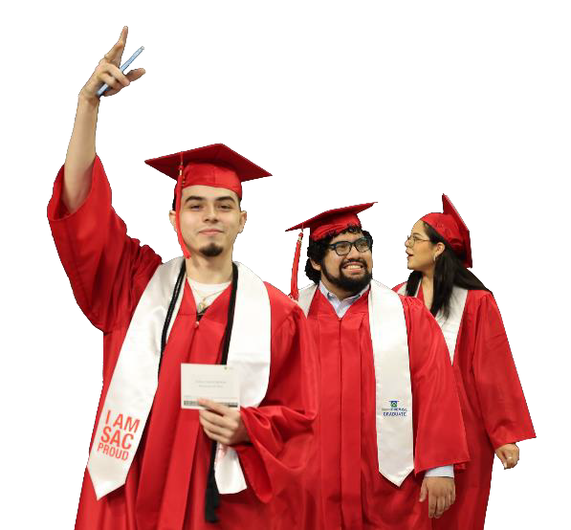


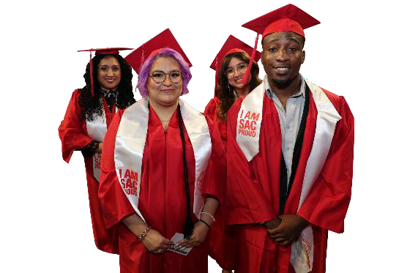
Average Time to Associate Degree
3.8
YEARS
4.4
4.3
4.3
4.1
3.7
YEARS
4.0
3.9
3.8
2022
3.8
2021
2019
2020
2023
Average SCH to Associate Degree
2023
67.2
Hours average Semester Credit Hours to Associate Degree
84 | 81 | 80 | 79 | 78
84 | 85 | 84 | 81 | 77
69.7 | 70.4 | 69.9 | 67.9 | 67.2
2019 | 2020 | 2021 | 2022 | 2023
San Antonio College Native Students
Native Students

Slide 17
Freshmen 3-Year Transfer Rates
39.8%
40.0%
33.4%
32.4%
33.4%
30.1%
30.0%
3-Year 6-Year
18.6%
20.0%
16.6%
15.9%
16.5%
14.6%
10.0%
2016
Source: National Student Clearinghouse
2017
2018
2019
2020

Slide 18





Where SAC Learners Transfer
(Academic Year 2023)
University of Texas – San Antonio (1,225)
Texas A&M – San Antonio (457)
Texas State University – San Marcos (299)
University of the Incarnate Word (298)
Western Governors University (271)

Slide 19
Graduation Rates of Transfer Students
Institution | Transfer Cohort
 | 2018 | 2019 | 2020 | 2021 | 2022
SAC | 68.1% | 68.9% | 69.6% | 64.8% | 69.3%
Alamo | 65.6% | 67.6% | 67.4% | 67.6% | 66.3%
Texas Peer Group Average | 61.4% | 62.1% | 62.2% | 63.8% | 64.5%
State Average | 62.2% | 63.8% | 63.6% | 65.1% | 65.2%

Slide 20
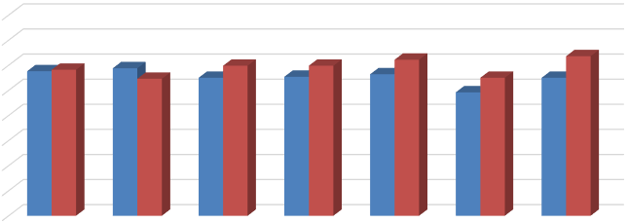
Learners Employed and/or Enrolled Within 6 Months of Graduation
100.0%
95.0%
90.0%
85.0%
80.0%
75.0%
70.0%
65.0%
60.0% | FY 2015 | FY 2016 | FY 2017 | FY 2018 | FY 2019 | FY 2020 | FY 2021
Academic | 88.8% | 89.4% | 87.5% | 87.7% | 88.2% | 84.6% | 87.5%
Technical | 89.1% | 87.3% | 89.9% | 89.9% | 91.1% | 87.5% | 91.8%

Slide 21

Would you Recommend this College to a Friend or Family Member?
100%
96% | 97.0% | 96.3% | 95.3% | 94.6%
92%
88%
84%
80%
76%
72%
68% | Alamo | SAC | Texas CC Avg | National Avg
97.0%
96.3%
95.3%
94.6%

Slide 22

Percentage of Students Rating their Entire Educational Experience as “Good or Excellent”
95%
90%
87.9%
87.6%
87.9%
87.2%
85%
80%
75%
70%
Alamo
National Avg
Texas CC Avg
SAC

Slide 23
Ruffalo Noel Levitz Results – Spring 2022 | Student Satisfaction Scores
6.31
6.11
6.01
5.94
5.90
5.91
5.92
5.87
5.78
5.81
5.79
5.68 _{5.66}
5.71
5.73
5.54
Academic Services
Campus Services
Concern for the Individual
Instructional Effectiveness
Responsiveness to Diverse Populations
SAC National
Safety & Security Service Excellence Student
Centeredness

Slide 24

Highlights & Achievements
SAC received the 2024 Carnegie Elective Classification for Leadership for Public Purpose.
Recognition signifies our institution’s exceptional commitment to developing leaders who serve the greater good.
25 currently classified institutions across the nation (SAC and Rice University from Texas).

Slide 25
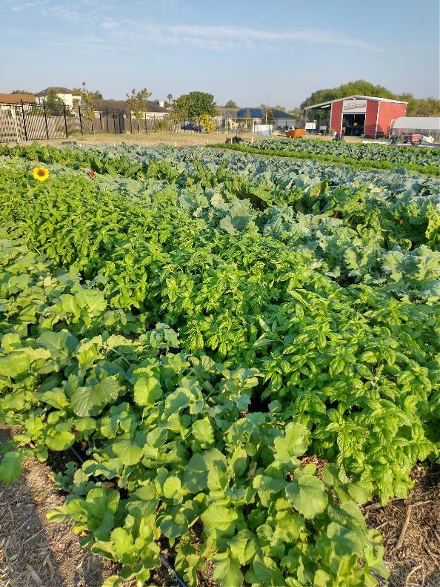
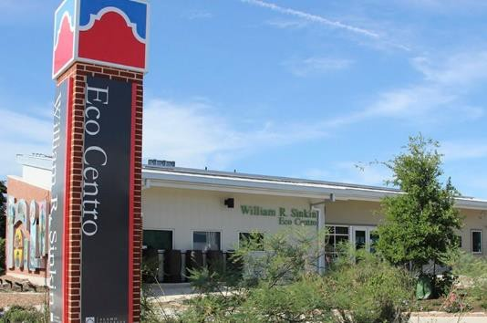
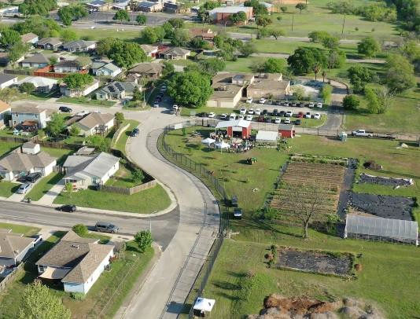
Highlights & Achievements
William R. Sinkin Eco Centro and
Garcia Street Urban Farm
A community and environmental sustainability center at San Antonio College that provides information and resources to positively address environmental and social challenges
Garcia Street Urban Farm is one of the only housing authority, community, and higher education-led urban farming and food production initiatives in the nation building safe, healthy, and sustainable environments for our neighbors, community members, students and the greater San Antonio area

Slide 26
Questions?

Slide 27
Appendices

Slide 28
Productive Grade Rates by Equity Subgroup
Demographic | Fall 2019 | Fall 2020 | Fall 2021 | Fall 2022 | Fall 2023
Asian | 84.03% | 87.92% | 88.11% | 84.74% | 84.17%
African American | 75.94% | 74.96% | 71.13% | 72.21% | 75.90%
Hispanic | 75.27% | 77.06% | 75.00% | 75.07% | 77.83%
White | 81.64% | 84.11% | 81.77% | 82.40% | 83.70%
Other | 79.01% | 82.11% | 78.73% | 83.61% | 86.62%
Female | 78.41% | 79.81% | 77.02% | 76.8% | 79.71%
Male | 74.98% | 77.13% | 75.39% | 75.9% | 77.89%
Non-Vet | 77.12% | 78.71% | 76.37% | 76.30% | 78.87%
Vet | 76.79% | 80.32% | 77.02% | 78.99% | 81.12%
Overall | 77.08% | 78.84% | 76.43% | 76.46% | 79.00%

Slide 29
Fall to Fall Persistence Rates by Equity Subgroup
Demographic | Fall 2018 to Fall 2019 |  |  | Fall 2019 to Fall 2020 |  |  | Fall 2020 to Fall 2021 |  |  | Fall 2021 to Fall 2022 |  |  | Fall 2022 to Fall 2023
 | FT | PT | Ttl | FT | PT | Ttl | FT | PT | Ttl | FT | PT | Ttl | FT | PT | Ttl
Male | 64.8% | 34.5% | 45.5% | 53.3% | 29.3% | 40.3% | 57.4% | 31.8% | 40.3% | 60.0% | 38.0% | 45.8% | 60.2% | 34.0% | 45.1%
Female | 69.3% | 43.2% | 53.3% | 59.4% | 36.8% | 47.6% | 60.6% | 35.8% | 45.7% | 61.4% | 39.0% | 47.9% | 65.0% | 39.6% | 50.7%
Vet | 61.3% | 42.5% | 50.7% | 60.5% | 44.1% | 51.0% | 48.6% | 51.7% | 50.5% | 39.3% | 58.7% | 52.7% | 63.0% | 32.8% | 42.4%
Non-Vet | 67.7% | 39.5% | 50.0% | 56.9% | 33.4% | 44.4% | 59.8% | 33.6% | 43.3% | 61.4% | 37.9% | 46.9% | 63.1% | 37.4% | 48.6%
Pell | 67.8% | 39.8% | 51.1% | 55.6% | 33.6% | 44.4% | 63.0% | 35.7% | 46.6% | 60.9% | 38.2% | 47.4% | 63.3% | 38.3% | 49.5%
Non-Pell | 66.9% | 39.2% | 48.6% | 59.8% | 34.0% | 45.1% | 55.0% | 32.5% | 40.2% | 60.7% | 39.1% | 46.6% | 62.9% | 35.6% | 46.5%
African American | 62.1% | 32.6% | 42.2% | 62.2% | 28.8% | 40.8% | 51.2% | 32.6% | 38.6% | 57.6% | 32.3% | 39.7% | 49.5% | 33.1% | 38.7%
Asian | 91.7% | 40.6% | 62.5% | 63.0% | 20.6% | 45.0% | 73.3% | 27.1% | 44.9% | 77.4% | 52.8% | 64.2% | 64.9% | 42.2% | 52.4%
Hispanic | 68.0% | 41.2% | 51.9% | 55.9% | 34.1% | 44.8% | 61.1% | 35.1% | 45.1% | 60.6% | 38.0% | 46.8% | 62.9% | 37.5% | 48.7%
White | 64.9% | 37.1% | 45.7% | 57.4% | 35.7% | 44.7% | 53.0% | 32.4% | 39.5% | 57.0% | 42.8% | 48.1% | 68.7% | 37.6% | 50.1%
Other | 52.9% | 40.0% | 44.7% | 68.4% | 36.8% | 52.6% | 61.5% | 33.3% | 41.9% | 94.4% | 41.4% | 61.7% | 80.0% | 43.5% | 62.5%

Slide 30
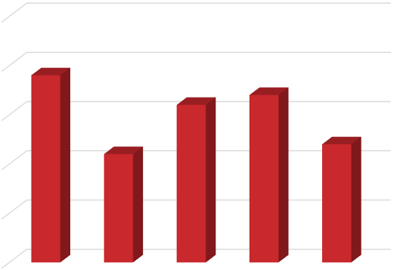
Number of High Challenge Courses
25
20
19
15
16
17
12
10
11
5
0
Fall 19* Fall 20* Fall 21*
Fall 22*
Fall 23*
* Terms do not include Corequisite Lab courses

Slide 31
High-Challenge Courses
ASTR 1303
BIOL 2401
CHEM 1405, 1411
COSC 1336
ENGL 1302
ITCC 1414
ITSC 1305
MATH 0410, 1332, 1414, 2412

Slide 32
3-Year Graduation Rates by Equity Subgroup
Demographic | Fall 2016 Cohort |  |  | Fall 2017 Cohort |  |  | Fall 2018 Cohort |  |  | Fall 2019 Cohort |  |  | Fall 2020 Cohort
 | FT | PT | Ttl | FT | PT | Ttl | FT | PT | Ttl | FT | PT | Ttl | FT | PT | Ttl
Male | 22.9% | 12.1% | 15.2% | 19.7% | 11.7% | 14.2% | 24.7% | 15.3% | 18.7% | 21.9% | 8.2% | 14.5% | 28.9% | 13.8% | 18.9%
Female | 32.3% | 14.6% | 19.1% | 28.3% | 16.1% | 19.4% | 27.6% | 18.1% | 21.7% | 22.4% | 12.9% | 17.4% | 29.5% | 15.2% | 20.9%
Vet | 31.3% | 28.0% | 29.9% | 38.5% | 21.4% | 30.9% | 45.2% | 24.4% | 33.3% | 30.2% | 27.9% | 28.8% | 39.5% | 21.0% | 28.0%
Non-Vet | 27.4% | 13.1% | 16.7% | 23.4% | 14.1% | 16.7% | 25.8% | 16.7% | 20.1% | 22.0% | 10.4% | 15.8% | 28.9% | 14.4% | 19.8%
Pell | 31.7% | 14.5% | 19.2% | 22.4% | 13.0% | 15.6% | 26.0% | 16.6% | 20.5% | 21.5% | 9.4% | 15.4% | 29.0% | 15.4% | 20.8%
Non-Pell | 22.8% | 12.3% | 15.0% | 26.8% | 16.0% | 19.3% | 26.6% | 17.2% | 20.3% | 23.6% | 13.4% | 17.8% | 29.6% | 13.9% | 19.3%
African American | 26.7% | 13.0% | 15.9% | 18.2% | 13.2% | 14.1% | 28.4% | 18.6% | 21.7% | 24.4% | 8.1% | 14.0% | 19.3% | 14.3% | 15.9%
Asian | 53.3% | 21.7% | 29.5% | 19.0% | 10.2% | 12.9% | 48.0% | 18.8% | 31.6% | 21.7% | 8.8% | 16.3% | 46.7% | 16.7% | 28.2%
Hispanic | 26.9% | 12.8% | 16.6% | 22.9% | 13.2% | 16.0% | 24.2% | 15.3% | 18.8% | 21.5% | 10.3% | 15.8% | 30.9% | 14.6% | 20.9%
White | 28.6% | 15.0% | 19.0% | 30.2% | 18.2% | 21.9% | 30.8% | 20.7% | 23.9% | 25.5% | 13.5% | 18.5% | 24.1% | 15.2% | 18.3%
Other | 25.0% | 13.2% | 16.0% | 33.3% | 26.9% | 29.5% | 41.2% | 20.0% | 27.7% | 15.8% | 21.1% | 18.4% | 15.4% | 6.5% | 9.1%

Slide 33
4-Year Freshmen Graduation Rates
35%
30%
25%
20%
15%
10%
5%
0%
33.3%
30.9%
28.2%
26.6%
Full-Time Part-Time
19.4%
22.0%
21.1%
15.9%
2016
2017
2018
2019
 | 2016 |  | 2017 |  | 2018 |  | 2019
 | FTIC | Grads | FTIC | Grads | FTIC | Grads | FTIC | Grads
FT | 676 | 225 | 825 | 233 | 976 | 302 | 1549 | 412
PT | 1851 | 359 | 2044 | 431 | 1629 | 359 | 1749 | 278

Slide 34
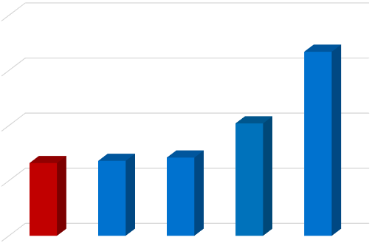
4-Year Freshmen Comparative Graduation Rates
40%
35%
36.7%
30%
30.2%
26.8%
27.1%
25%
26.6%
20%
SAC
VLCC Avg
State Avg
Alamo
SPC (Peer Best)

Slide 35
Degrees & Certificates Awarded by Gender
3,000
2,500
2,000
1,500
1,000
500
-
 | 2,515 | 2,320
 |  |  | 2,102
 | 1,687 |  |  | 1,849 | 1,799
 |  | 1,406 | 1,267 | 1,167 | 1,073
 | 2019 | 2020 | 2021 | 2022 | 2023
Male | 1,687 | 1,406 | 1,267 | 1,167 | 1,073
Female | 2,515 | 2,320 | 2,102 | 1,849 | 1,799

Slide 36
Degrees & Certificates Awarded by Ethnicity
3,000
2,500
2,000
1,500
1,000
500
-
 | 2,499 2,198 _{2,077 1,971 1,909} 1,078 _{1,010} 795 ₆₃₂ ₅₄₇ ³⁸² ²⁹⁹ 269 253 245
 | 2019 | 2020 | 2021 | 2022 | 2023
White | 1,078 | 1,010 | 795 | 632 | 547
African American | 382 | 299 | 269 | 253 | 245
Hispanic | 2,499 | 2,198 | 2,077 | 1,971 | 1,909
Asian | 115 | 112 | 116 | 81 | 96
Other | 128 | 107 | 112 | 79 | 75

Slide 37
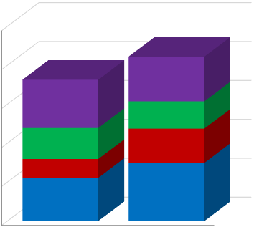
Fall Full Time FTIC 3-Year Tracking
84.5% | 945
100%
72.6% |
Left in Good Standing Still Enrolled at SAC National Transfer Graduated from SAC
80%
23.0% 257
60%
24.8% 384
14.0% 157
15.9% 246
9.7% 151
40%
17.6% 197
20%
29.9% 334
22.2% 344
0%
Fall 2019 Cohort
Fall 2020 Cohort

Slide 38
Graduates as a % of Full Time Equivalent Enrollment
Institution | Percentage
 | 2019 | 2020 | 2021 | 2022 | 2023
SAC | 44.1% | 37.8% | 39.1% | 34.1% | 31.3%
Alamo | 38.9% | 37.4% | 39.1% | 40.5% | 36.8%
Peer Group Average | 30.8% | 30.8% | 34.2% | 34.9% | 34.8%
State Average | 32.6% | 32.2% | 36.2% | 37.0% | 37.5%

Slide 39
Student Services – Dr. Barbara Hong, VPSS
Academic Services – Dr. Jon Lee, Dean AS
College Services - Dr. Stella Lovato, VPCS
Division Addresses

Slide 40
      Centennial – Victoria Moe
      4 dx – Usha Venkat
      SACSCOC & QEP – Dr. Jones
College Updates

Slide 41


Slide 42
Centennial – Celebrating 100 Years
Tell the SAC Story – Past, Present and Future​
Engage the SAC Campus, alumni, and community in celebrating SAC’s legacy in San Antonio​
  Volunteer Recruitment and Engagement Events​
  SAC Centennial Advisory Council​
  Founder’s Day Picnic
  Series of Strategic Conversations ​
  Speaker Series
  Centennial Gala ​
III. Raise funding to support student services ​
Interested in volunteer opportunities? Email Victoria Moe at vmoe@alamo.edu.

Slide 43

93+ Teams currently participating in 4DX
SAC 4DX Update
54 Teams achieved Wildly Important Goals in Spring 2024
16 Teams achieved Wildly Important Goals in Summer 2024
13 Summit Cycles to Date
12 Summit Cycles to Date
12 Summit Cycles to Date

Slide 44

      2023-2024:
      Increase total annual contact hours from Spring 2,203,360 (FY23 actual) to 2,380,980 (FY24) by 8/25/2024.
      Achieved Result:
      2024-2025:
      Increase total annual enrollment from 45,084 (FY24 actual) to 46,969 (FY25) by 10/25/2025.
Spring/Summer – College WIG Update

Slide 45
SAC Integrated Planning Approach
College Integrated Planning
College Measures(KPI)
Strategic Planning (SPOL)
Student Learning Assessment (eLumen)
Unlocking Opportunity
Smart Goals (AlamoTalent)
4DX

Slide 46
4DX Support
4DXOS.COM
4DXOS.com creates visibility and transparency with executing strategies. Provides leaders with visibility of their team and organizational goals and how they are performing against those goals.
4DX Support Site in SharePoint - alamo0.sharePoint.com
Teams can close out the WIGS on the SharePoint site. Allows institution to capture data and learnings.
4DX Training – AlamoTALENT/One-on-One Support
A team of coaches are available to assist you with the process.
Instructional Innovation Center – MLC 712

Slide 47

      SACSCOC Reaffirmation Timeline
      - Compliance Report submitted by the end of February
      - Quality Enhancement Plan due in August
      - Campus Visit September 22-25
      Quality Enhancement Plan
      - The SAC community voted for the Mental Health & Resilience theme 2:1 over the other topics.
      - Theme evolving into the utilization of wrap-around services (including mental health services) to support student resilience and persistence.
      - Please send an email to Dr. Joan Jaimes by October 4th if you are interested in serving on the QEP committee. This committee is open to faculty, staff, administrators, and students.
      - For SAC Scores in the spring, this committee will update the College on the progress of the QEP.
SACSCOC & QEP

Slide 48
      Strategic Planning – Catherine Coppersmith
      Institutional Research – Dr. Savithra Eratne
      Learning Assessment – Rosalind Ong
Integrated Planning & Performance Excellence (IPPE) Updates

Slide 49
Strategic Planning

Slide 50
      KPIs
      Use of Data Reports
      711 Courses by Faculty members,
      712 Disciplines by Discipline/Prog. Coordinators,
      713 Programs by Program Coordinators,
      741 Individual Commitment by Staff members
Institutional Research

Slide 51
      • Marketable Skills Week – September 30 – October 5
      • Academic Assessment Committee:
      Rubric Review - Leadership & Communication
      • Learning Assessment Validation Committee
      Value Institute Training – Written Communication
      • eLumen insights – Pilot – Late Fall
Learning Assessment
SAC-slos@alamo.edu

Slide 52
Questions

Slide 53
      Unit Level work session (Faculty, Staff, Chairs, Directors)
Location to be determined by Unit
Division Discussion (Faculty, Staff, Chairs, Directors, Deans, VPs):
Student Success – Introduction from VP Student Success - Location determined by Division
Academic Success – Introduction from VP Academic Services - Location determined by Division
College Services – Introduction from VP College Services - Location determined by Division
  SAC Scores Division Unit Highlights: SAME Webinar LINK
      Student Success, Academic Success, College Services
      SAC Scores deliverables updates provided to Supervisor
Schedule
10:30 a.m. – 2:00 p.m.
2:00 - 3:30 p.m.
2:00-3:00p.m.
Snack Hour: Loftin Employee Lounge
3:30 - 4:00 p.m.
5:00 p.m.

Slide 54
SAC Scores
Data
Reflection
Insights
Improvement

Slide 55
Thank you for attending
Fall 2024

